Slide 1
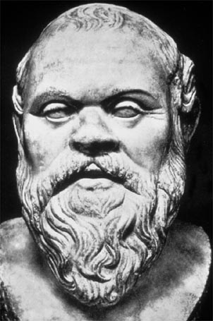
Socrates
Why is he the inspiration for this class?

Slide 2
Historical Context
5th century (BC) Greece
Athens at height of power – conquered Persians
Intellectual and artistic excellence
1st Democracy successful
Civic pride – perhaps hubris?
Arete (virtue) is Kleos (fame)
Sophists predominant teachers.

Slide 3
Sophists and Rhetoric
Sophists were paid to teach rhetoric:
The art of effective/persuasive speaking.
Language designed to have persuasive effect.
Socrates attacked the Sophists as focusing on technique/style rather than substance.

Slide 4
Sophists and Rhetoric
“Sophistry” now means “deceptively subtle reasoning or argumentation.”
Rhetoric has both a positive and negative connotation:
Language that persuades effectively.
Language that is insincere and/or empty.

Slide 5
Rhetoric in the News
http://google.com/

Slide 6
The Wisest Man
The Oracle said that Socrates was the wisest man because “he knows that he doesn’t know.”
This drives all his thinking and his influence on Western Civilization
Socrates -> Plato -> Aristotle -> Alexander the Great

Slide 7
Think for Yourself
Socrates taught by asking questions
Socratic Method
Objective: get people to “know that they don’t know.”
First, essential, step to real wisdom.
Suspicious of the obvious.

Slide 8
Philosophy for Everyone
Walked streets engaging people in dialogue
Not solitary pursuit
Ideas connected to real life, real people

Slide 9
A Simple Man
No shoes
Few clothes
Insisted he not be paid for “teaching.”
Got along with all classes of people – charming
Ugly

Slide 10
Courage to Challenge Authority
Women should be educated.
Politics is not the answer.
Individual people thinking for themselves are.
He challenged prevailing opinions:
Especially, the idea that Athens was superior, infallible, and special.

Slide 11
Dying for the Truth
Sentenced to death by Athenian court for “corrupting the youth” with dangerous ideas.
Declined opportunity to escape death by confessing to being wrong.

Slide 12
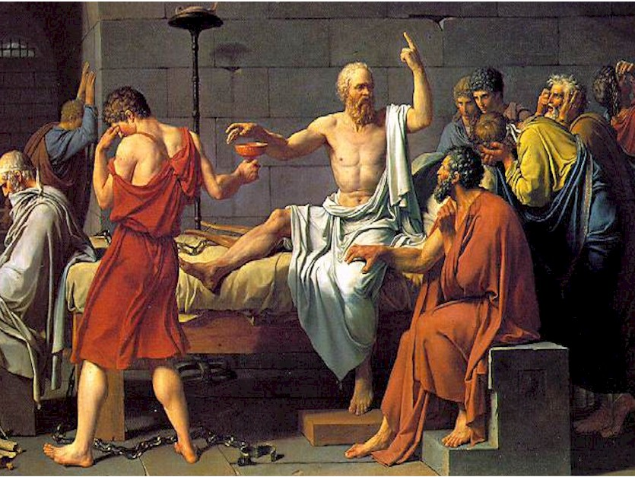
The Death of Socrates by Jacques Louis-David

Slide 13
How will Socrates inspire you in this class?

