Slide 1
Propaganda

Slide 2
Propaganda defined – an act
“The spreading of ideas, information, or rumor for the purpose of helping or injuring an institution, cause, or person.”
- Webster’s Dictionary

Slide 3
Propaganda defined – the words
“Ideas, facts, or allegations spread deliberately to further one’s cause or to damage an opposing cause.”
- Webster’s Dictionary
“Propaganda” has a negative connotation.

Slide 4
What fits the definition?
Advertising?
Political campaigns?
War posters?
School spirit posters?
“Swat the Hornets!”
Newspapers?
Scientific journals?
Academic writing?

Slide 5
Propaganda is a form of persuasion
Audience/purpose
Ethos
Logos
Pathos – often the most important element:
Hope of gain
Fear of loss

Slide 6
Transfer
The act of relating something positive with a product.

Slide 7
Testimonials
The use of well-known, respected people to endorse a product or service.

Slide 8
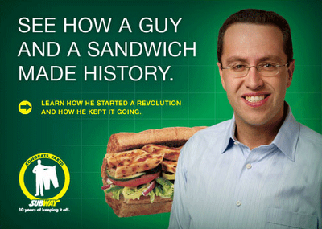
Plain Folks
The use of everyday people to sell a product or service.

Slide 9
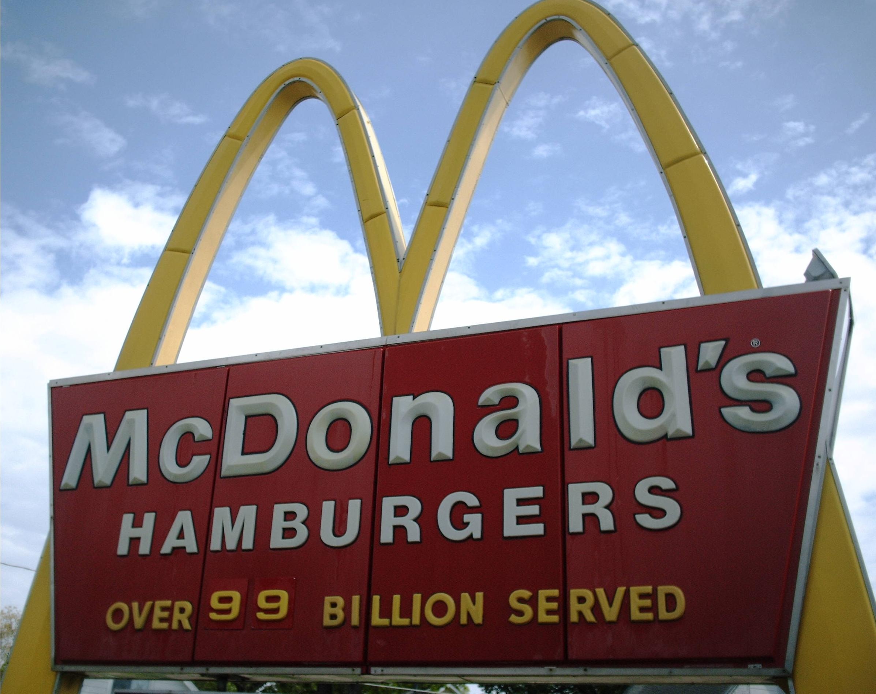
Bandwagon
The technique of appealing to people to join the crowd.

Slide 10
Glittering Generalities
The use of vague words that evoke a positive emotional response from an audience but actually convey no real information.

Slide 11
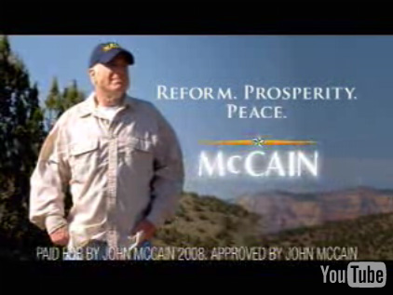
Glittering Generalities - Politics
In politics, these words are often used:
Freedom
Security
Prosperity
Independence
Tradition
Change

Slide 12
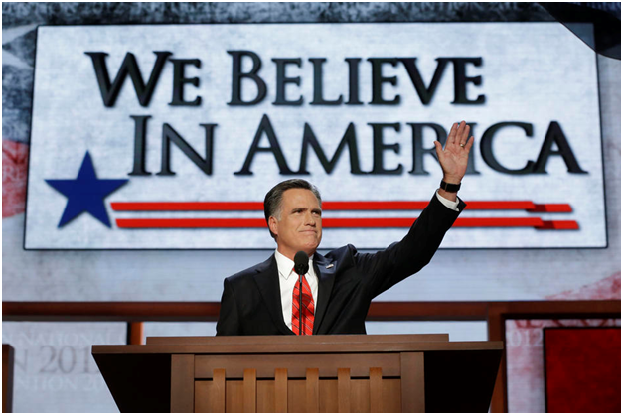
No one is exempt

Slide 13
Name Calling
In politics, this often links a person or idea to a negative symbol or idea rather than examining the evidence.
“Tax and spend liberals”
“Socialist” ideas
“Right wing radicals”
“Tree huggers”
Often used to evoke fear and/or hatred

Slide 14
Name Calling
Another name for Ad hominem
Connotation is critical
“Stingy” vs. “thrifty”
“Confident” vs. “arrogant”

Slide 15
Card Stacking
Showing only the facts that support your position while omitting facts that may hurt your position.

Slide 16
Good Propaganda
Propaganda does not always have a negative purpose.

Slide 17
The hard part
To distinguish between propaganda and effective persuasion
Both use many of the same techniques
Effective persuasion tries to
Provide objective evidence for a position
Provide the whole truth, including counterarguments

