Slide 1
The Declaration of Independence
1,337 words that changed the world

Slide 2
Thomas Jefferson said the Declaration of Independence was “intended to be an expression of the American mind.”
What is the “American mind?”

Slide 3
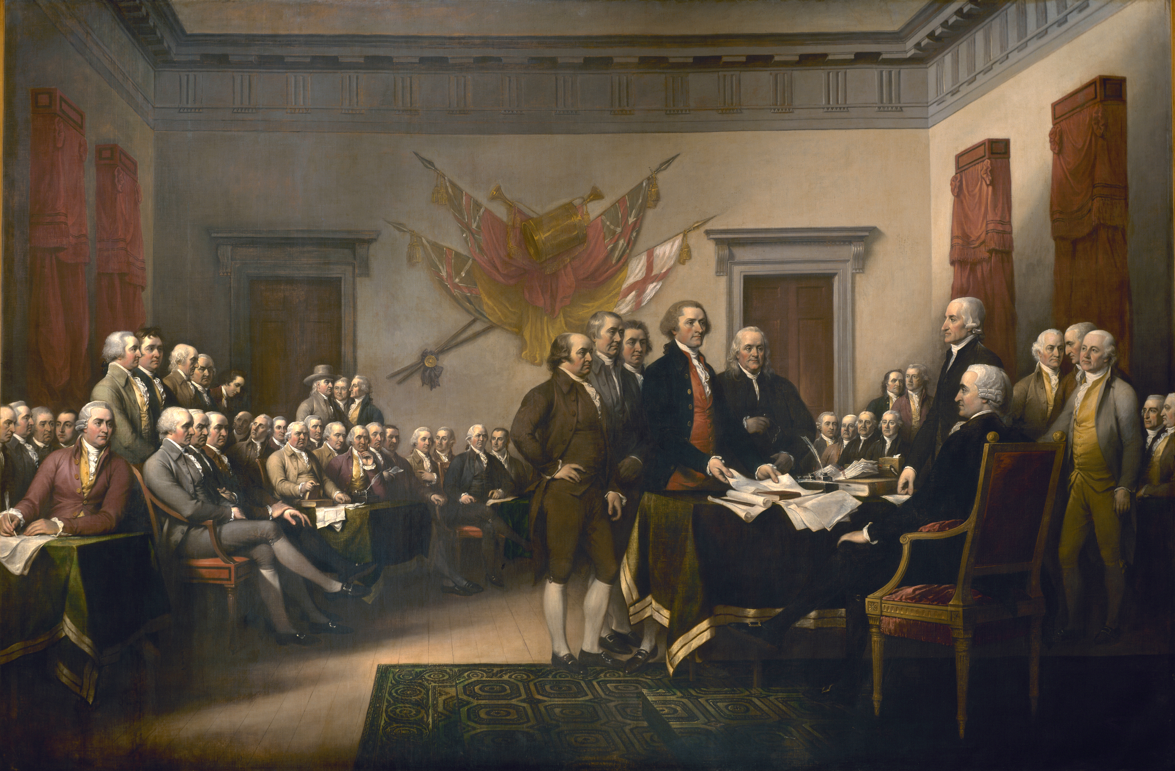
Notes:
John Trumbull 1818 Placed in rotunda of US Capitol.

Slide 4
Not boring old guys in stockings. They were complex, flawed people.
“Why He Was A Babe Magnet
Even when he was old and rotund, Ben had sex appeal. He knew the way to a woman's heart was through her head.”
- Time Magazine headline, 2003

Slide 5
Secrets only recently confirmed
Jefferson had a long-term affair with his slave, Sally Hemings after his wife died.
Sally was the half sister of his deceased wife.
The affair started when she was a teenager and he was 30 years older.
For more information, see the Monticello website: www.monticello.org

Slide 6
John Adams tells Jefferson why he has to write it
Reason first. You are a Virginian and a Virginian ought to appear at the head of this business. Reason second. I am obnoxious, suspected, and unpopular; you are very much otherwise. Reason third. You can write ten times better than I can.
(Adams’ account of the conversation)

Slide 7
But it was a group effort
5 people contributed to the draft including
Jefferson – who actually spoke infrequently in Congress
Ben Franklin
John Adams
Congress made edits to the draft
Stylistic and political
Professor Danielle Allen calls it “Democratic Writing”
from Our Declaration: A Reading of the Declaration of Independence in Defense of Equality

Slide 8
We ought to consider what is the end of government, before we determine
which is the best form. Upon this point all speculative politicians will agree,
that the happiness of society is the end of government, as all divines and moral
philosophers will agree that the happiness of the individual is the end of man.
- from Thoughts on Government, by John Adams, March 1776

Slide 9
This was the object of the Declaration of Independence. Not to find out new principles, or new arguments, never before thought of, not merely to say things which had never been said before, but to place before mankind the common sense of the subject, in terms so plain and firm as to command their assent, and to justify ourselves in the independent stand we are compelled to take.
…it was intended to be an expression of the American mind, and to give to that expression the proper tone and spirit called for by the occasion.
- Thomas Jefferson to Henry Lee, 1825

Slide 10
Historical context
For centuries, political rule (kingship) was considered – and justified – as a gift from God.
“Divine right of kings.”
Philosophers Thomas Hobbes, John Locke, and Jean-Jacques Rousseau provided arguments against this position.
Locke and Rousseau described political power coming from the people.

Slide 11
The logical argument: deductive reasoning
All people have rights to life, liberty, and the pursuit of happiness.
Properly constituted government is necessary to their securing these rights.
Implied: all people have a right to whatever is necessary to secure what they have a right to.
All people have a right to a properly constituted government.

Slide 12
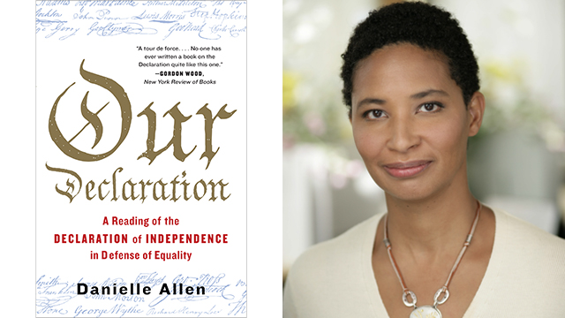
Exigence: while teaching low-income adults at night on the South Side of Chicago, she rediscovered the text.
Chosen by Northwestern University to be read by all incoming freshman and professors in 2017-2018.
“If we abandon equality, we lose the single bond that makes us a community, that makes us a people with the capacity to be free collectively and individually in the first place”

Slide 13
Men only? - Prof. Allen’s argument
Like “equality” Jefferson’s use of a word in other places in the document give us a clue:
“Determined to keep open a market where men should be bought and sold…”
Men and women were bought and sold as slaves.
Therefore, “all men created equal” means men and women.

Slide 14
Only whites equal? - Prof. Allen’s argument
The Confederates thought they were correcting the errors of the Declaration.
The original American Union ”rested upon the assumption of the equality of the races…Our new government is founded on exactly the opposite ideas… the negro is not equal to the white man...
Alexander Stevens, Vice President of the Confederate States of America
Prof. Allen: “our ideas seem often to run ahead of our habits.”

Slide 15
Purpose and Audience (always!)
Dual purpose:
Justify to a ”candid world”
see paragraphs 1, 2
Fire up the colonists
Hyperbole: “swarms of new officers”
Less than T. Paine’s “The Crisis”?

Slide 16
Understanding audience
Focus anger and accusations on king, NOT
British people
British parliament
– see Congress’ edits (last paragraph)
Prudence – paragraph 2.
Addresses fear that revolution will occur too frequently

Slide 17
The overall structure – per Prof. Allen
Declare reasons
Present facts – king’s offenses
Declare independence
Make pledges to each other - ”our lives, our fortunes, and our sacred honor.”

Slide 18
Issues to consider
Liberty vs. equality: are they opposing ideas?
Community?
The French revolution’s motto was “Liberty, Equality, Fraternity”
The role of religion/God
Compare to Paine – “The Crisis”

